Slide 1
Big data mining task
BuddyMove Data Set
Link GitHub: https://github.com/silvisalputri/TugasBesar_DataMining_049_053

Slide 2
Member’s name
Kevin Timoteus Sirait (3311901049)
https://github.com/HadesShade
Silvi Salputri (3311901053)
https://github.com/silvisalputri

Slide 3
Dataset
Title: BuddyMove Data Set
Abstract: User interest information extracted from user reviews published in holidayiq.com about various types of point of interests in South India
Data Set Characteristics: | Multivariate, Text | Number of Instances: | 249 | Area: | N/A
Attribute Characteristics: | Real | Number of Attributes: | 7 | Date Donated | 2018-07-01
Associated Tasks: | Classification, Clustering | Missing Values? | N/A | Number of Web Hits: | 32408
Source: https://archive.ics.uci.edu/ml/datasets/BuddyMove+Data+Set

Slide 4
Dataset Explanation and Analysis
Source: Shini Renjith, shinirenjith '@' gmail.com
Data Set Information:
This dataset was populated from destination reviews published by 249 reviewers of holidayiq.com till October 2014. Reviews falling in 6 categories among destinations across South India were considered and the count of reviews in each category for every reviewer (traveler) is captured.
Attribute Information:
Attribute 1 : Unique user id
Attribute 2 : Number of reviews on stadiums, sports complex, etc.
Attribute 3 : Number of reviews on religious institutions
Attribute 4 : Number of reviews on beach, lake, river, etc.
Attribute 5 : Number of reviews on theatres, exhibitions, etc.
Attribute 6 : Number of reviews on malls, shopping places, etc.
Attribute 7 : Number of reviews on parks, picnic spots, etc.

Slide 5
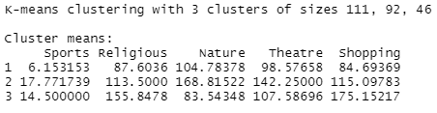
Data Mining Process
Download dataset from https://archive.ics.uci.edu/ml/datasets/BuddyMove+Data+Set
Move the dataset to working directory
Use K-Means algorithm method in Rstudio from column number 2 to 6
Create the plot for column 2 and 3 based the clustering model and give some attracted property
clust1 <- kmeans(data[2:6],3)
clust1
plot(data[2:3], col = clust1$cluster)
points(clust1$centers, col = 2:3, pch = 8, cex =2)

Slide 6
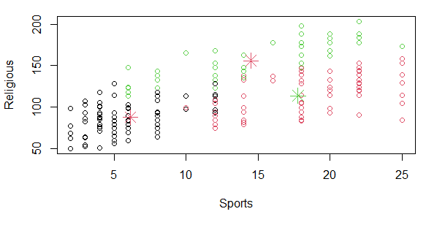
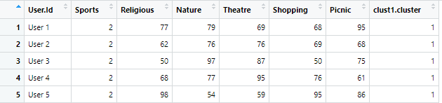
Data Mining Results
The result displays a Sport object in the form of a plot image and there are 3 cluster points.
View the data and cluster number in a new table
result <- data.frame(data,clust1$cluster)
View(result)

Slide 7
Source
Dataset Source: https://archive.ics.uci.edu/ml/datasets/BuddyMove+Data+Set
Link Project: Link GitHub: https://github.com/silvisalputri/TugasBesar_DataMining_049_053
Link Kevin’s github account: https://github.com/HadesShade
Link Silvi’s github account: https://github.com/silvisalputri

